Slide 1
Decision Trees vs Neural Networks for Classification of Emotions from Text
A DATA MINING AND MACHINE LEARNING PROJECT

Slide 2
Introduction
Extracting emotions from text has many applications
Customer feedback analysis
Health monitoring
In this work I compare
Decision Trees
Random Forests
Neural Networks

Slide 3
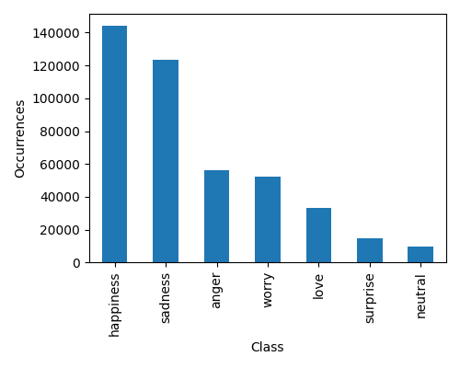
Data
Two datasets of labelled tweets were merged
CrowdFlower (40,000 instances)
Emotions (400,000 instances)
The resulting dataset has 7 emotions and is unbalanced
A weight for each class was used to train the models

Slide 4
Models

Slide 5
Results

